Slide 1
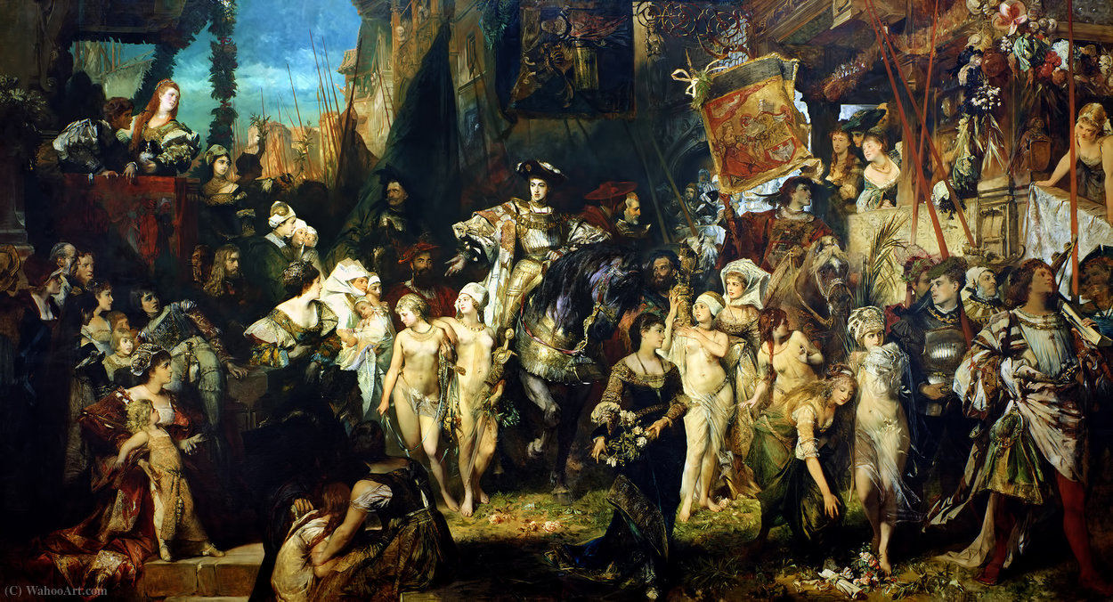
ProvokArt
Speech-based interaction in a VR art gallery for HTC Vive
Manuele Veggi, manuele.veggi@studio.unibo.it
“Laboratorio di VR & AR”, Prof. Gustavo Marfia
MA “Digital Humanities and Digital Knowledge”
Università di Bologna, a.a. 2022/2023

Slide 2

The context. MakArt Project
Translation of the MakartNow project (Hamburger Kunsthalle) into an immersive virtual environment
Each painting is commented by a set of “provocative” questions
Cognitive goal: stimulate the visitor and catalyze personal reflection on crucial themes

Slide 3
How do you see power depicted here?
Facts – are they
as important as imagination?
Do you find the painting provocative? Do you think it’s sexist?
Hans Makart, The Entry Of Charles V Into Antwerp, 1878

Slide 4

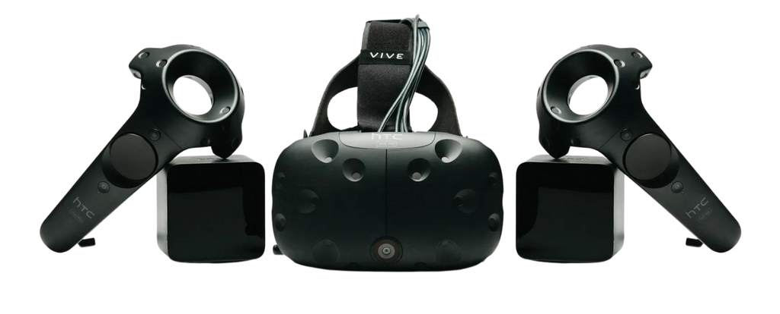
The environment and the hardware.
3D gallery based on the room of the Kunsthalle
Exploration of the environment through HTC Vive

Slide 5
Modelling the interaction
Painting
(or area of the room)
User
Collision box
Set of questions
can enter
Random selection of
2
Question
Storage
answer through
Speech-based interaction
Speech-to-Text
transcription
1
Notes:
1. The user can teleport within the environment
2. Each painting is associated with a set of related questions and is defined by a collision box
3. As soon as the user enters the collision box of a painting a question from the related set is extracted and shown to the user
4. The user can answer to the question and the answer is transcribed (speech to text)

Slide 6
Open issues and possible solutions
1
Speech-to-Text
Google Speech-to-Text
Cognitive Speech SDK
Voice input in Unity
2
Saving the transcription
Possibility of creating a corpus collecting all the interactions?
Possible advantage: NLP analysis on the corpus
…

Slide 7
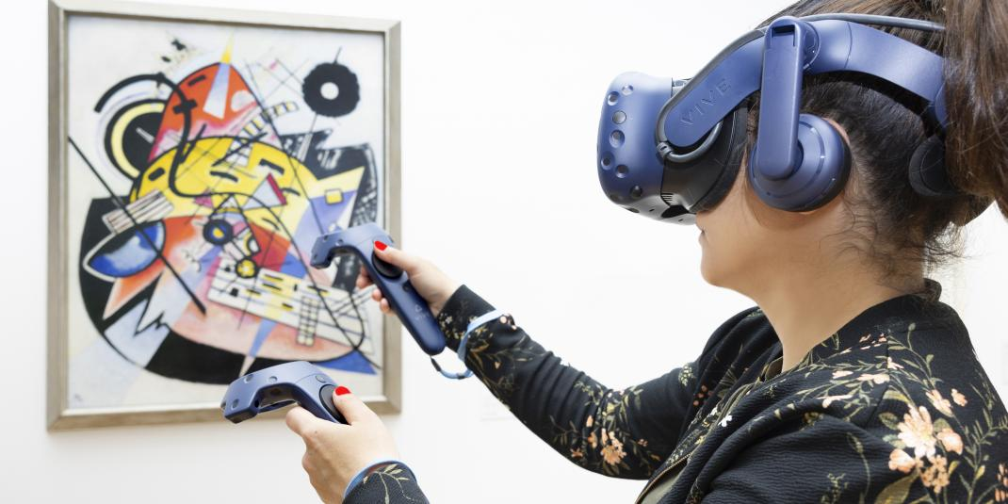
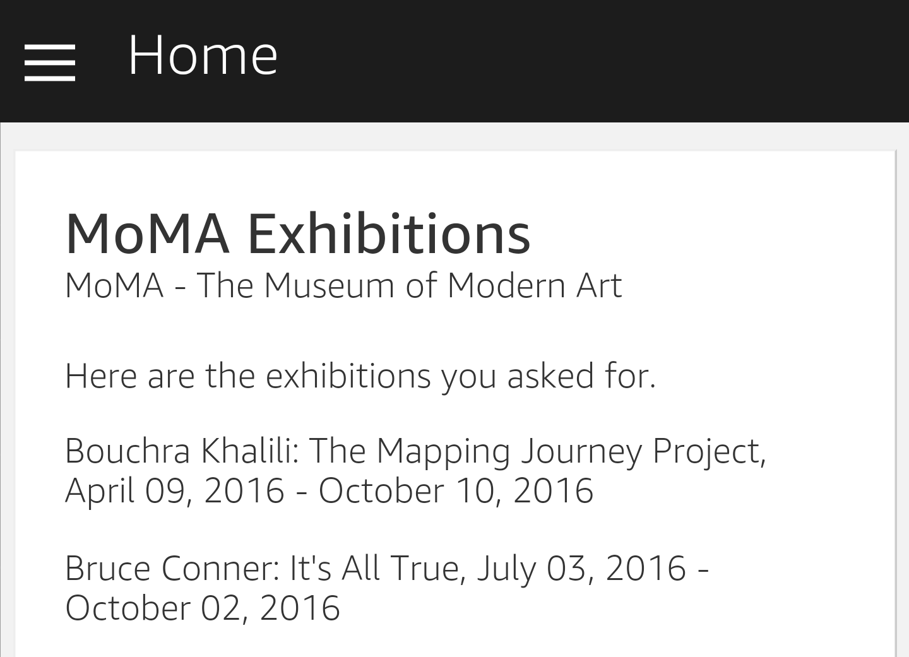
Related projects
See, Hear, Play Kandinsky! – Hamburger Kunsthalle
VR experience through HCTVive
Same institution of MakartNow: Hamburger Kunsthalle
Acoustic interaction with the work of art
A case study on using voice technology to assist the museum visitor (Moore et al 2017)
Non-immersive technology
Speech-based interaction with the user (Alexa)

Slide 8
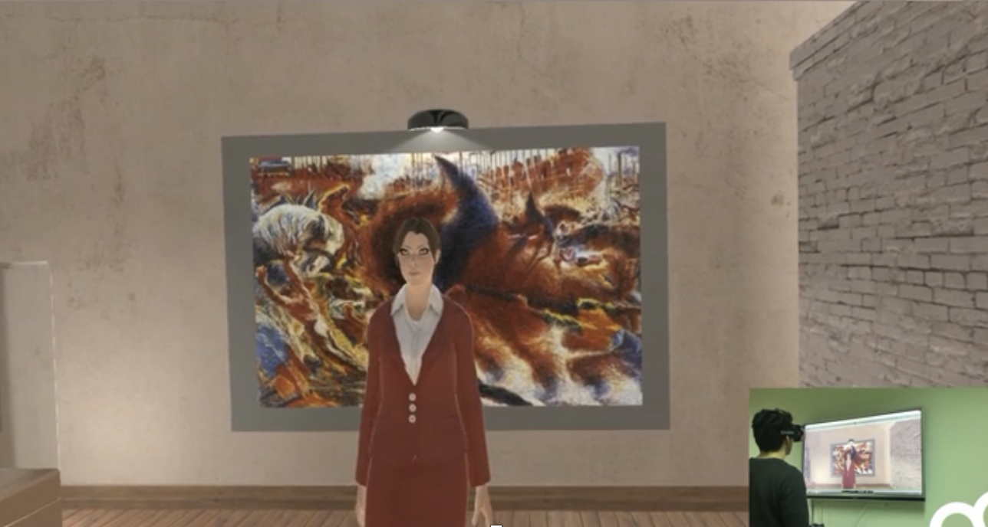
Natural Experiences in Museums through Virtual Reality and Voice Commands (Ferracani et al 2017)
Immersive experience for a museal context (OculusRift for VR)
Use of speech to give commands
Relies on Microsoft Speech API

Slide 9
Possible bibliographical references
Al-Nafjan, A., Alghamdi, N. & A. Almudhi (2021). “Virtual Reality Technology and Speech Analysis for People Who Stutter”. EMITTER International Journal of Engineering Technology, 9(2): 326–338.
Bowman, D. A., Rhoton, C. J. & M. S. Pinho (2002). “Text input techniques for immersive virtual environments: An empirical comparison”. Proceedings of the human factors and ergonomics society annual meeting, 46 (26): 2154-2158.
Dorozhkin, D. & V. Judy. (2002). “Implementing Speech Recognition in Virtual Reality”. ASME 2002 International Design Engineering Technical Conferences and Computers and Information in Engineering Conference.
Ferracani, A., Faustino, M., Xavier Giannini, G., Landucci, L. & A. Del Bimbo (2017). “Natural Experiences in Museums through Virtual Reality and Voice Commands”. Proceedings of the 25th ACM international conference on Multimedia (MM '17).
González, G., Molina, J.P., García, A.S., Martínez, D. & P. González (2009). Evaluation of Text Input Techniques in Immersive Virtual Environments. In: Macías, J., Granollers Saltiveri, A. & P. Latorre (eds.), New Trends on Human–Computer Interaction. Springer, London.
He, Z., Lv, C., Peng, D. & D. Yu. (2017). “A speech recognition-based interaction approach applying to immersive virtual maintenance simulation”, Second International Conference on Reliability Systems Engineering (ICRSE).
Moore, S., Pan, D., & M. Engineer (2017). “A case study on using voice technology to assist the museum visitor”. MW17 Museums Web.
Nooriafshar, M. (2015). Application of Speech Recognition Technology to Virtual Reality System. Proceedings of the 2015 International Industrial Informatics and Computer Engineering Conference.
Stedmon, A. W., Patel, H., Sharples, S. C., & J. R. Wilson (2011). “Developing speech input for virtual reality applications: A reality based interaction approach”. International Journal of Human-Computer Studies, 69 (1-2): 3–8.

